Slide 1
OOP WITH C++ Project on Concert Registration System Group-13

Slide 2
TEAM MEMBERS
PRANTIK BARIK
AADRIKA JAISWAL
OMKAR MISHRA
SURYA PRATAP SINGH VARMA
ROLL: 21051218
ROLL: 21051531
ROLL: 21051230
ROLL: 21051608

Slide 3
CONTENTS
INTRODUCTION
ISSUES TO BE RESOLVED
CONCEPTS IMPLEMENTED
IMPLEMENTATION
RESULT DISCUSSION
CONCLUSION
REFERENCES

Slide 4
INTRODUCTION
Concert’s are a huge deal in India.
For the most people and even for many event marketers, the only bottleneck is the registration process. When it comes to designing an experience for a concert, most frequently, they are questioning how to do a registration.
Maintaining a proper and accurate Concert Registration system is essential for the easy flow of the registration process.
An efficient concert registration system requires maintaining booking records for the concert at both the admin end and the user end.
C++ being an object oriented programming language, can very well satisfy the need for this efficient concert registration system.
Thus we have designed a fully functional Concert Registration System using C++. It is a one stop Concert registration service for clients where they can book their event with everything at one place. This system currently has Client Registration, Book Tickets, Cancel Ticket alongwith an Admin’s End where admin can Add, Cancel or View Events all at one place, You do not need to contact different people for different tasks. Everything is available on a single click.

Slide 5
ISSUES TO BE RESOLVED
Admin’s End
User’s End
ISSUE - 03
User/Client Registration
Book Tickets
ISSUE - 04
Cancel Ticket
ISSUE - 01
Add Concerts
Remove Concerts
ISSUE - 02
View Concerts
Modify Ticket Prices

Slide 6
ISSUE 1: Admin’s End Add Concert Remove Concert Done By: Prantik Barik
Concepts Implemented: Class & Objects Constructor & Destructors File Handling Scope Resolution Operator Standard Template Library

Slide 7
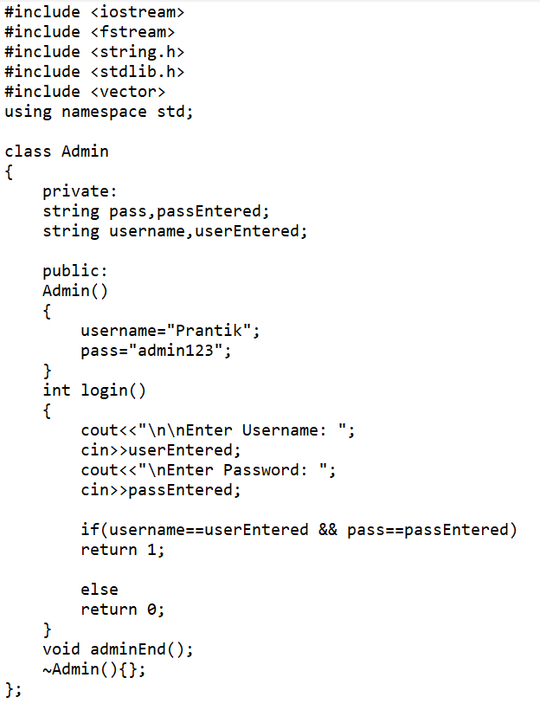
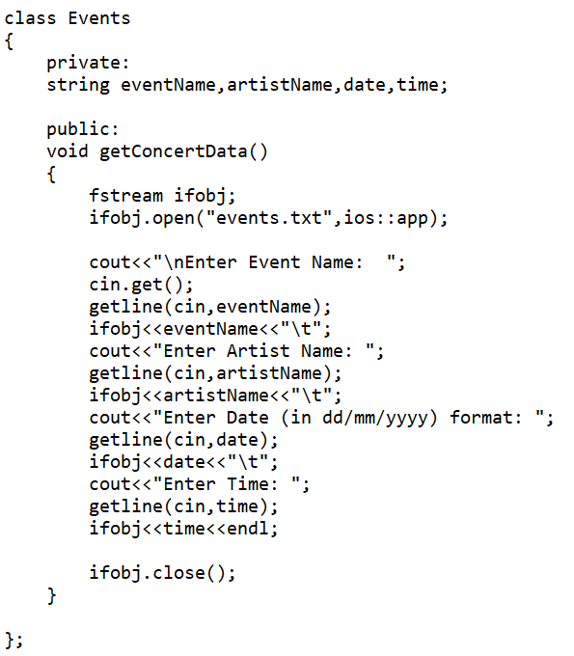
Implementation Code

Slide 8
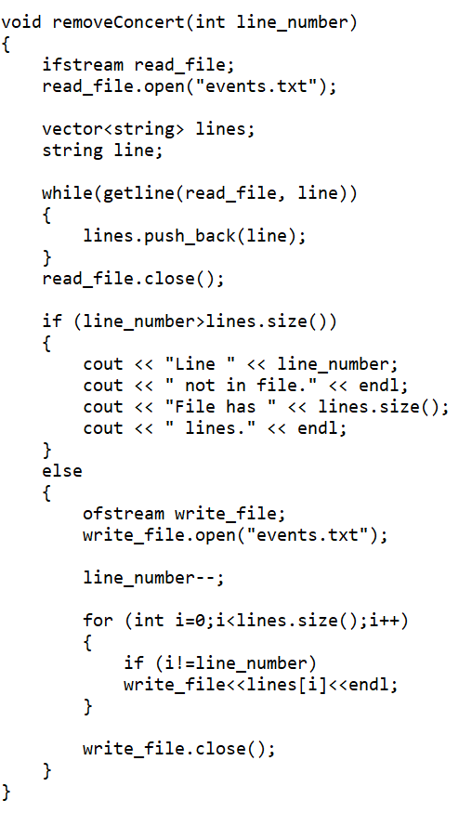
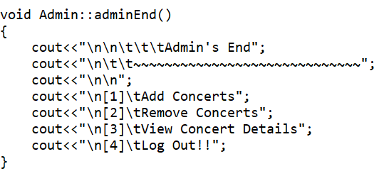
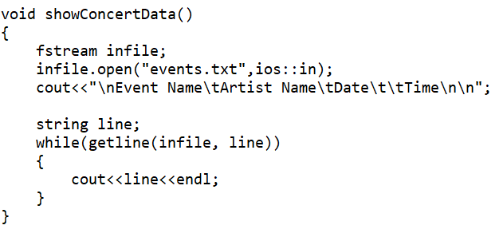
Implementation Code

Slide 9
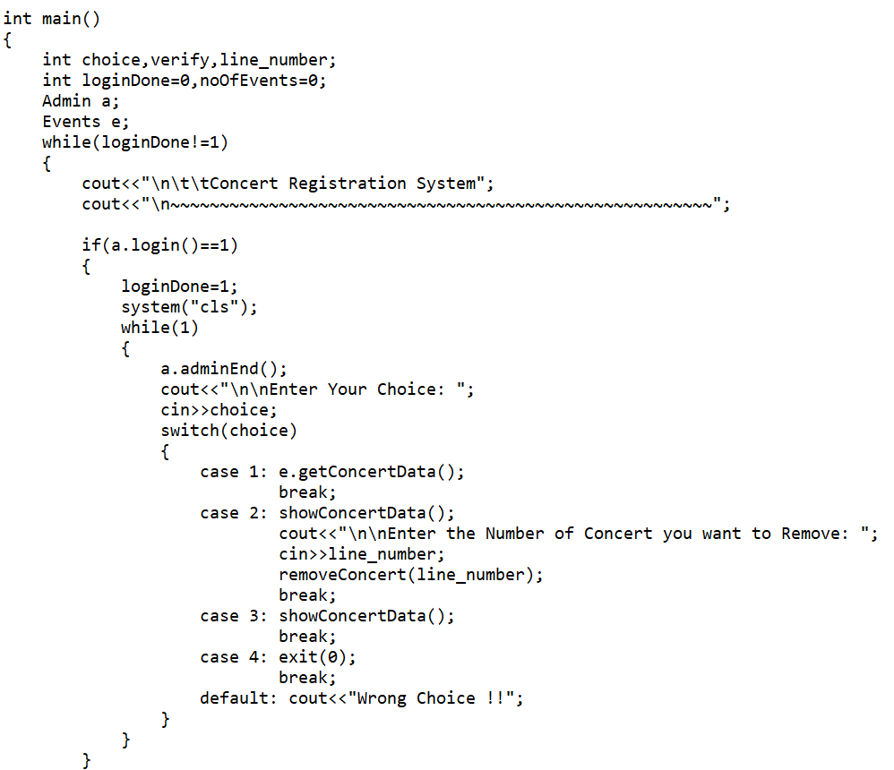
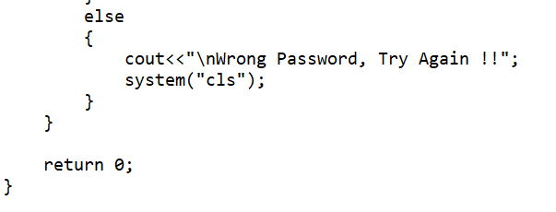

Implementation Code

Slide 10
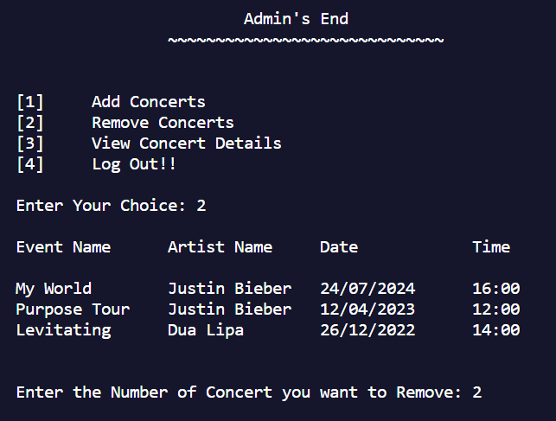
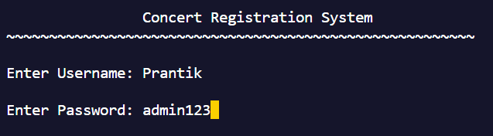
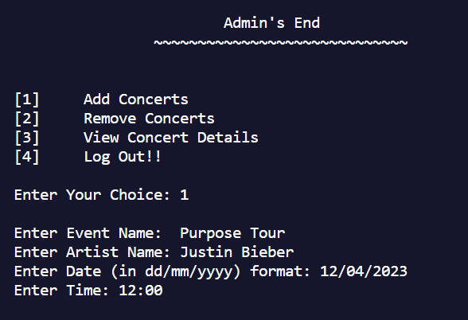
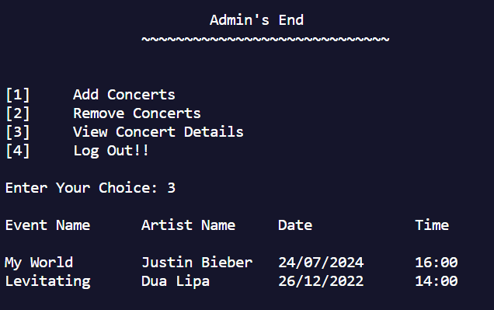
OUTPUT

Slide 11
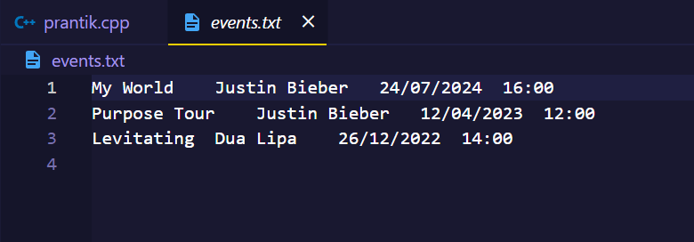
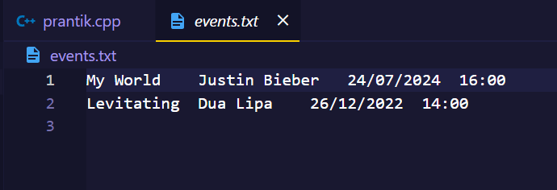
OUTPUT
FILE VIEW(ADD CONCERT)
FILE VIEW(REMOVE CONCERT)

Slide 12
ISSUE 2: Admin’s End View Concert Modify Concert Done By: Surya Pratap Singh Varma
Concepts Implemented: Class & Objects Single Inheritance Array of Objects Virtual Function

Slide 13
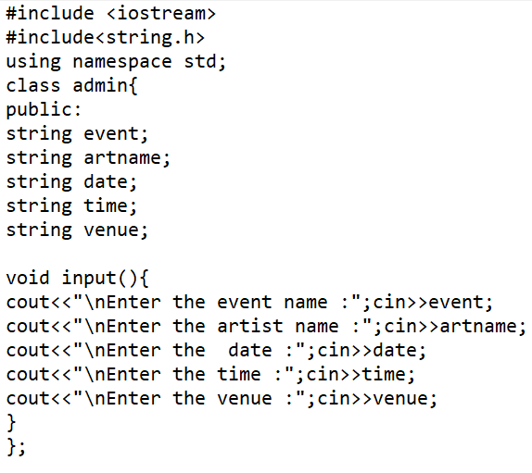
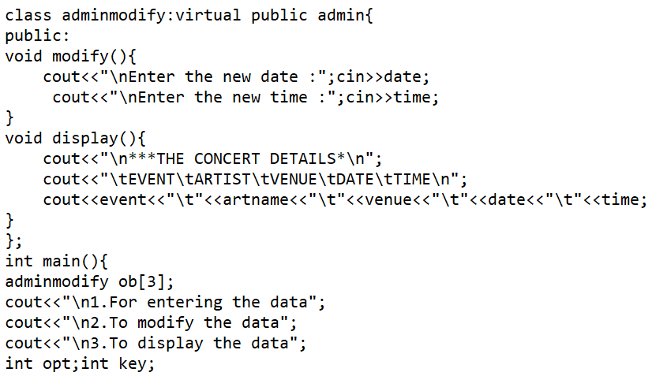
Implementation Code

Slide 14
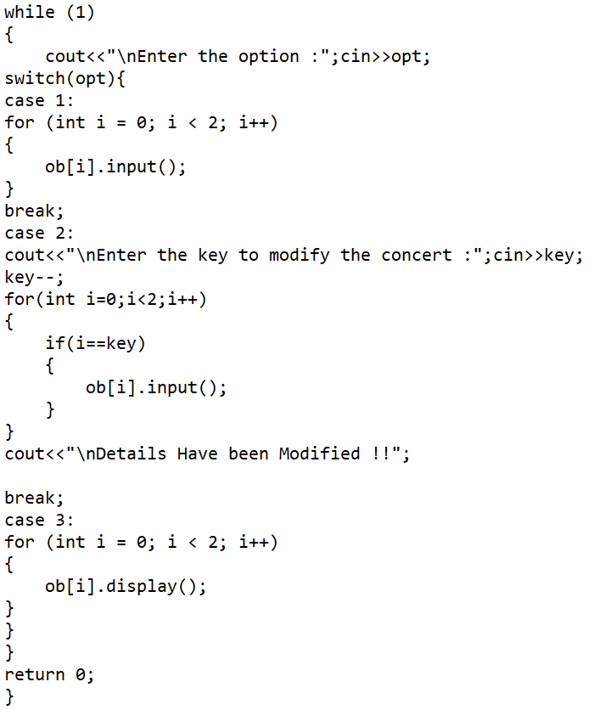
Implementation Code

Slide 15
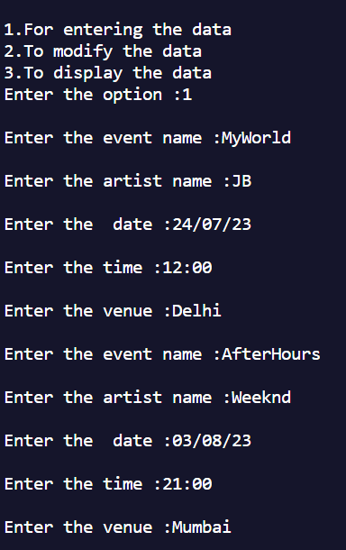
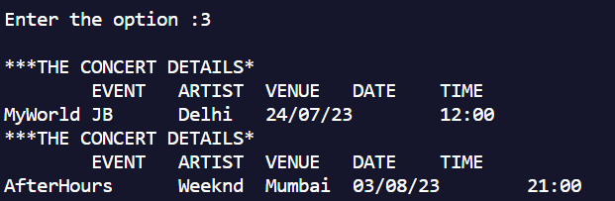
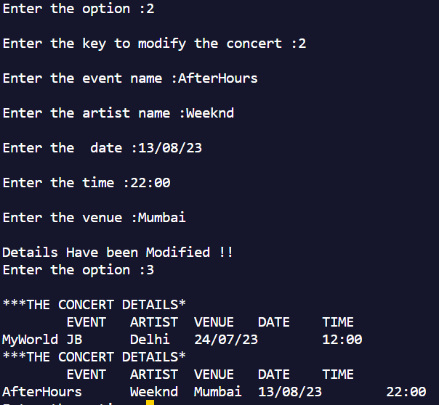
OUTPUT

Slide 16
ISSUE 3: User’s End User Registration Book Tickets Done By: Omkar Mishra
Concepts Implemented: Class & Objects Default Constructor File Handling Scope Resolution Operator
Static Variable

Slide 17
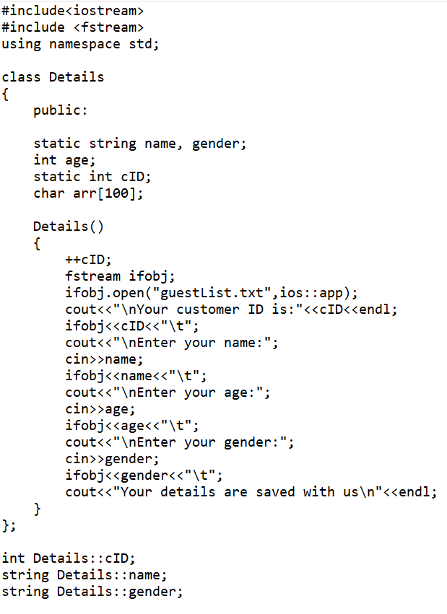
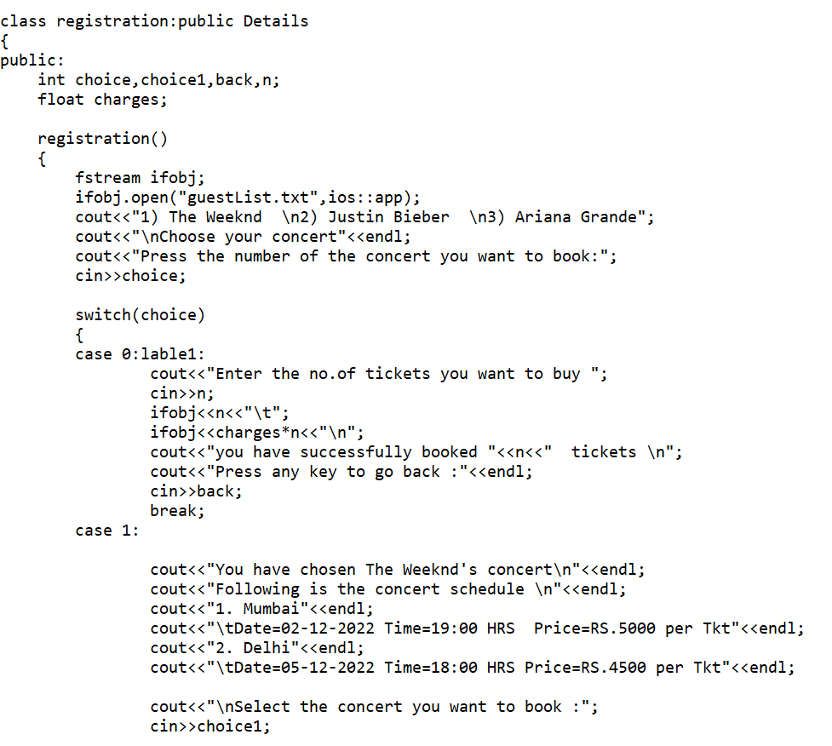
Implementation Code

Slide 18
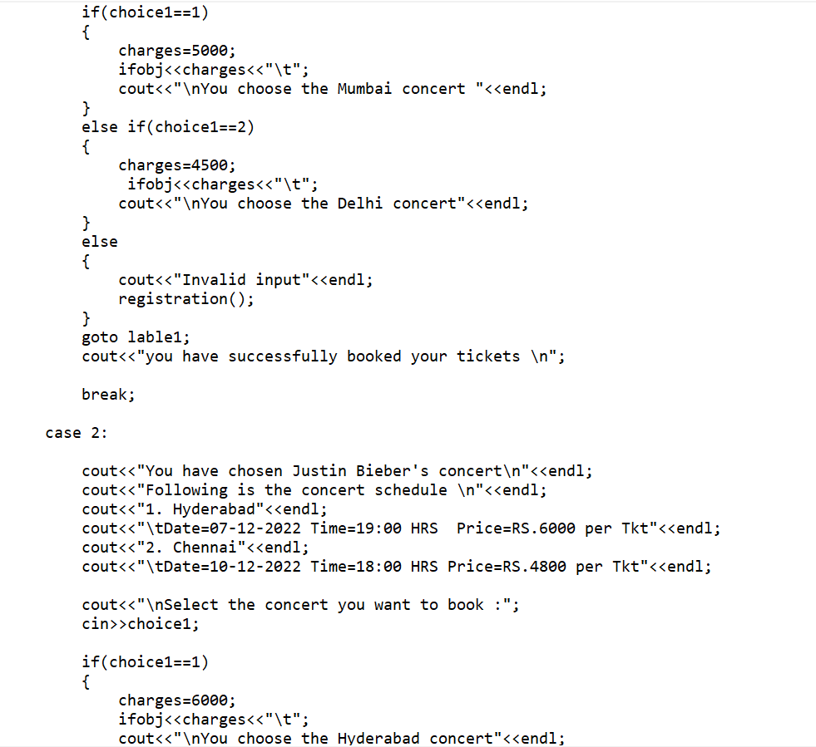
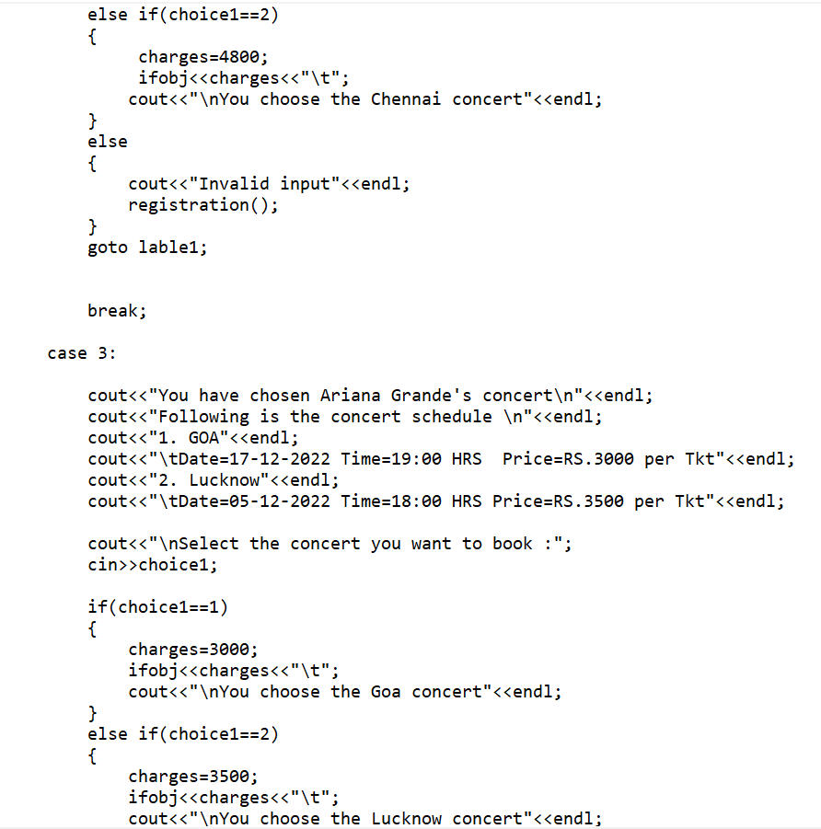
Implementation Code

Slide 19
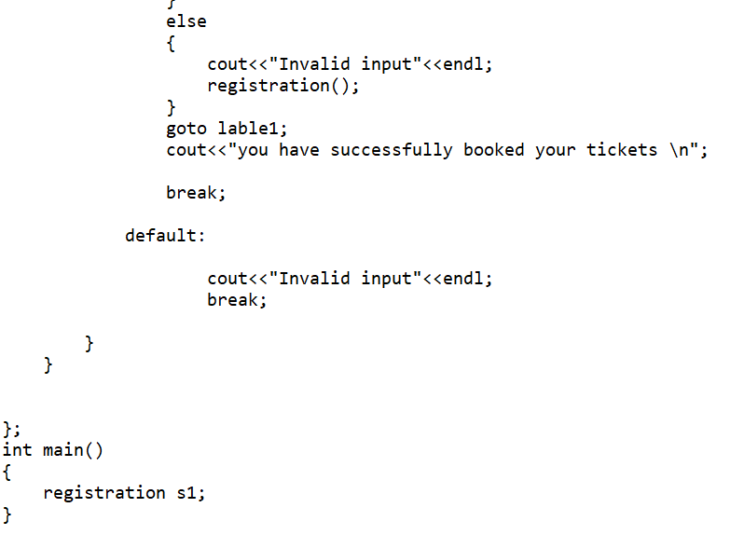
Implementation Code

Slide 20
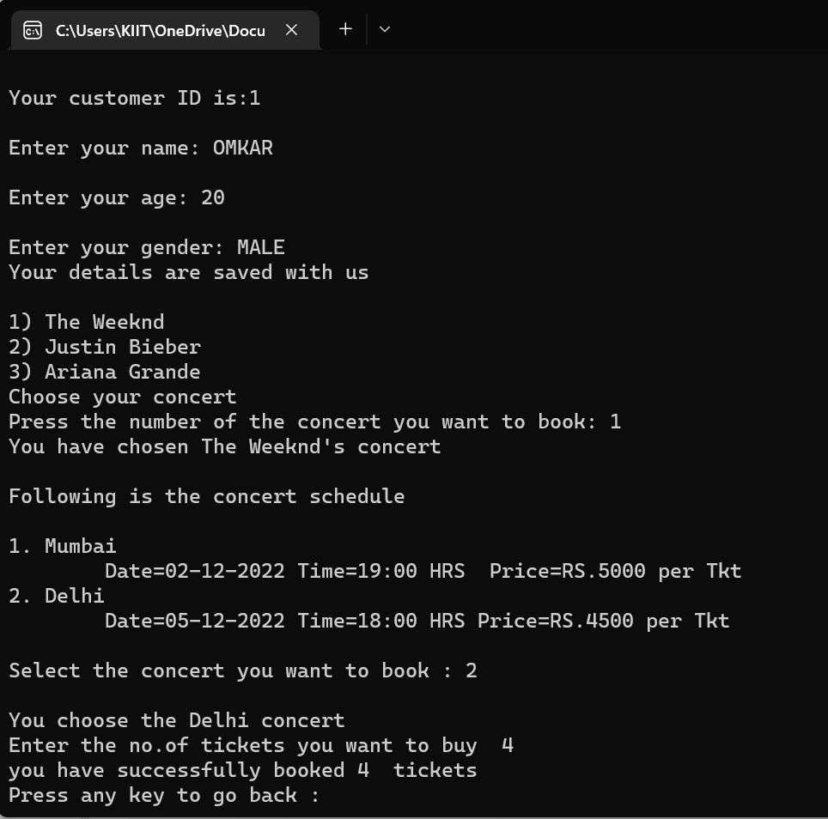
OUTPUT

Slide 21
ISSUE 4: User’s End Cancel Tickets Done By:Aadrika Jaiswal
Concepts Implemented:
Class & Objects
Constructors
Array Of Objects Friend Function & Friend Class Scope Resolution Operator

Slide 22
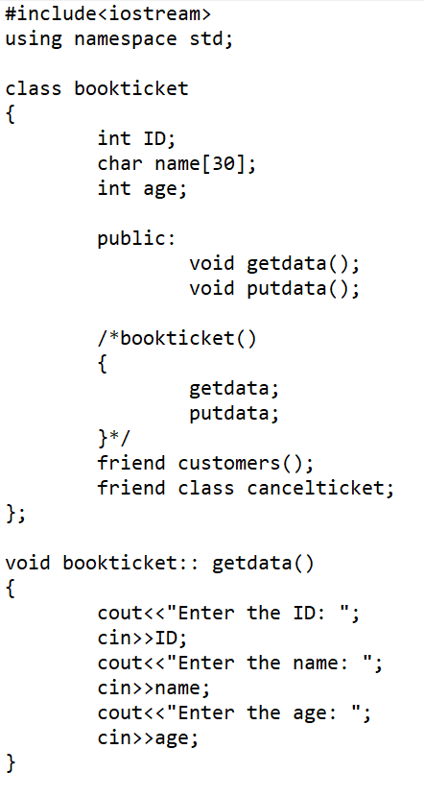
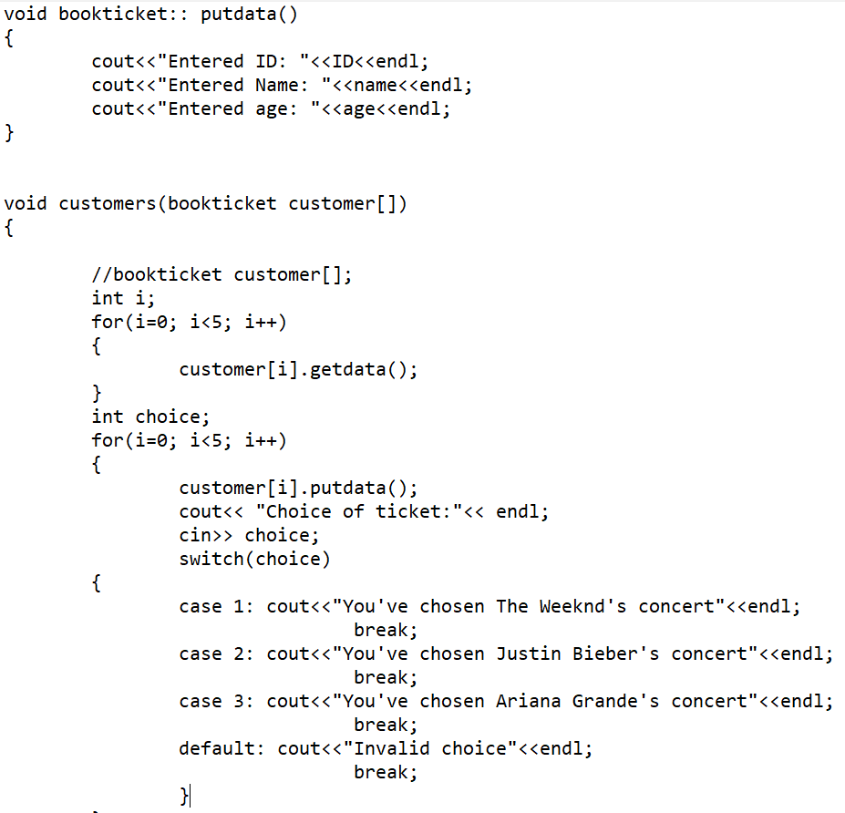
Implementation Code

Slide 23
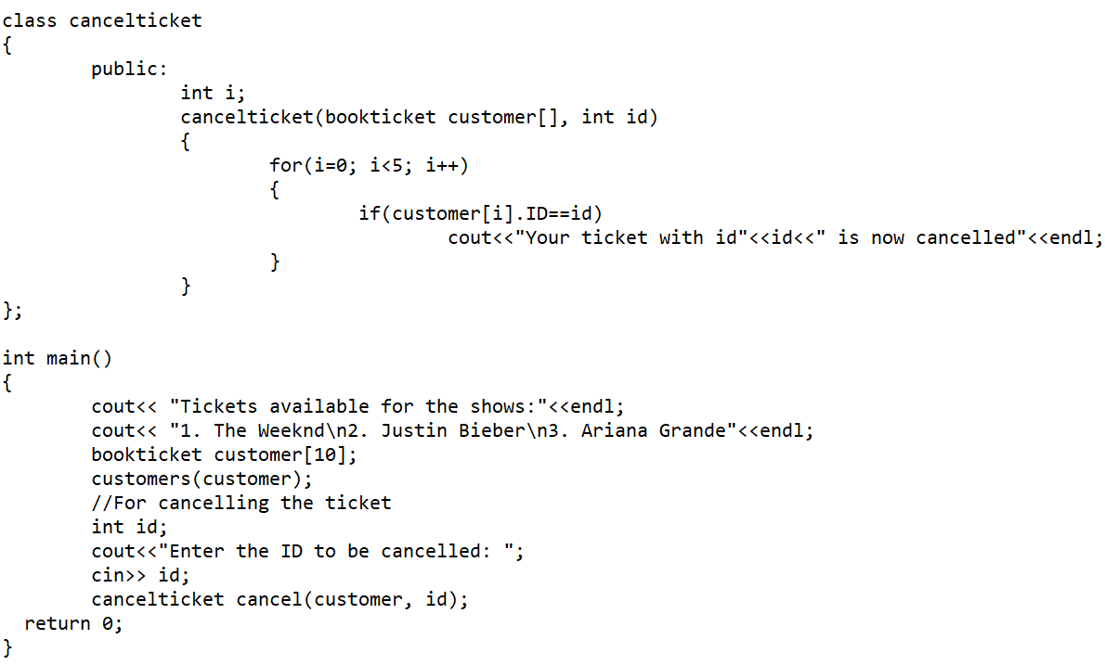
Implementation Code

Slide 24
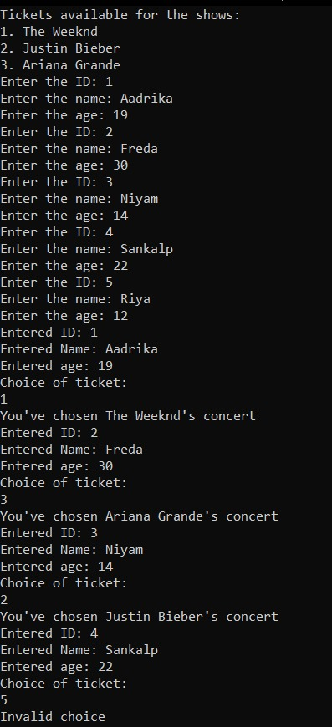
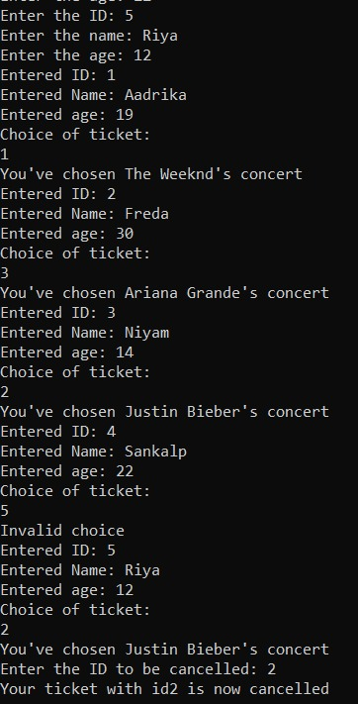
OUTPUT

Slide 25
CONCLUSION
From this mini project on Concert Registration System, we conclude that C++, an Object Oriented Programming Language can ease the process of coding in order to maintain the records of bookings and cancellations or modifications from both Admin as well as User’s End.
The data encapsulation, abstraction and friend function and classes facilities in this language provides is great help in maintaining the security as well as simplicity of the codes to maintain the Registration system and records.

Slide 26
REFERENCES
Ideas Taken From:
1. https://github.com/HxnDev/Event-Management-System-
in-JavaFX
2. GeeksForGeeks & Reference Books

Slide 27
THANKS!

